Slide 1
Flocking
Rationale
To display realistic group behaviour
Examples
Birds, Fish, Sheep, Borg, Squad behaviour
Three Simple rules
Cohesion
Steer towards average position of neighbours
Alignment
Steer so as to align to average velocity of neighbours
Separation
Steer so as to avoid colliding with neighbours
Result is called emergent behaviour

Slide 2
Flock Properties
Units are steerable
Knowledge of other unit positions and headings
Units need only local knowledge
No one unit is in charge
No one unit has global or complete knowledge of flock
Behaviour emerges from whole
Murmuration-Lough Ennell, Co. Wesatmeath, 2021
Notes:
https://www.youtube.com/watch?v=Oe6zrkQwJMw
https://www.youtube.com/watch?v=V4f_1_r80RY

Slide 3
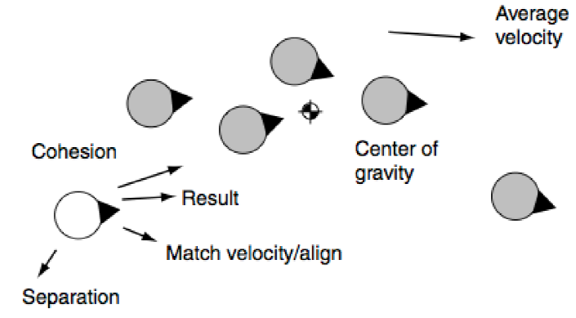
Parameters
How far can we see (sense)
Radius R
What is our field of view
Angle Θ
Simple flocking – use equal weights
But general rule of importance:
separation, cohesion, alignment
Changing values of parameters
changes flock behaviour

Slide 4
Parameters
Small radius R
Unit senses fewer other flock units
Therefore fragmentation can occur
Large radius R
More cohesive flock
Smaller angle Θ
Units tend to flock “narrowly” –single file
Larger angle Θ
Units flock more realistically

Slide 5
Parameters
We tune parameters to match circumstances
Total Force is
W_{C} * Cohesion + W_{A} * Alignment + W_{S} * Separation
We choose our weights to give “required” behaviour
Cohesion influence inversely proportional to number of neighbours
Alignment influence proportional to difference between our heading and average heading
Separation influence inversely proportional to distance between us and our neighbours

Slide 6
Basic Algorithms
Cohesion is position matching
Alignment is velocity matching
Separation is Separation
All three compute new linAcc, rotAcc values
Gather all three values and apply weights
They can all be combined into one loop
Calculations can be simplified if we are clever!

Slide 7
Calculating alignment
For each unit in flock:
If (unit <> this):
If (unit within radius) and (unit in FieldOfView):
Calculate Position Matching
Calculate Velocity Matching
Calculate Separation
Combine all three accelerations using forces
Don’t forget to check that they are less than maxAcceleration

Slide 8
Obstacle Avoidance
Units should flock around obstacles
They need to be able to “see” items in their path
There are many approaches to this
Once an imminent collision is detected
Feed the corrective action into FSM

Slide 9
Example Scenario
A flock of sheep should flock together (flocking) while simultaneously wandering around the environment (wandering) avoiding trees (obstacle avoidance) and scattering (evade) whenever a human or dog comes near.
Imagine a class called SteeringBehaviours which has a method for each steering algorithm.
Each sheep owns an instance of this class and can activate/deactivate behaviours as necessary.
e.g.
Sheep.steering.SeparationOn();
Sheep.steering.AlignmentOn();
Sheep.steering.CohesionOn();
Sheep.steering.ObstacleAvoidanceOn();
Sheep.steering.WanderOn();
Sheep.steering.EvadeDogOn();
Check out www.massivesoftware.com
Notes:
The lord of the rings: movement of the orc armies used steering behaviours via software called Massive:
http://www.massivesoftware.com/

Slide 10
Leaders
To do useful and/or purposeful behaviour a flock needs a leader to make decisions
How do we choose a leader?
Any unit with no units directly in front of it becomes a leader
We need two fields of view
Standard FoV for flocking
Narrow FoV for deciding on leadership
Compute Unit number in narrow FoV
If equal to zero then do leader stuff
Chase, Avoid, Wander
Otherwise do flocking stuff
Example from Half-Life
Notes:
If we simply use the above general rule for choosing a leader, instead of designating one, then we cover the situation of a leader getting destroyed and the group becoming leaderless.

Slide 11
Swarming
Rationale
Display realistic unit and group behaviour
A little more chaotic looking
Examples
Swarming bees or insects, panicked crowd movement
Should include
Obstacle avoidance, Chasing and Evading
Make use of potential forces

Slide 12
Lenard-Jones Potential function
U = -A/r^{N} + B/r^{M}
A, B, N, and M are constants
U is the potential energy of attraction and repulsion
Inversely proportional to the separation distance
Force of attraction
-A / r^{N}
Force of Repulsion
B / r^{M}
r is the distance between the two objects
Notes:
Check out: http://chemwiki.ucdavis.edu/Physical_Chemistry/Physical_Properties_of_Matter/Intermolecular_Forces/Lennard-Jones_Potential
Or a good diagram at: http://chemistry.stackexchange.com/questions/34214/physical-significance-of-double-well-potential-in-quantum-bonding

Slide 13
Lenard-Jones Potential function
We adjust or tune the constants until we realise the behaviour we want
A, B : Strength of Attraction and Repulsion (resp.)
N,M : Attenuation of Attraction, Repulsion (resp.)
Go check out the function diagram!
Notes:
Check out: http://chemwiki.ucdavis.edu/Physical_Chemistry/Physical_Properties_of_Matter/Intermolecular_Forces/Lennard-Jones_Potential
Or a good diagram at: http://chemistry.stackexchange.com/questions/34214/physical-significance-of-double-well-potential-in-quantum-bonding

Slide 14
Simple Algorithm
Function CalcLJ(Unit me, Unit you)
vector R = me.position - you.position
real D = R.magnitude()
real U = -A/pow(D,N)+ B/pow(D,M)
R.normalise()
me.Applyforce(R*U)

Slide 15
Obstacle Avoidance
Set A to zero
No attractive force
Sum up force between object and all obstacles
Ideal for circular or spherical obstacles
Could use many small spherical objects to approximate any shape

Slide 16
Swarming
Similar to flocking
But more like a swarm (obviously)
For each object in the swarm
Calculate sum of Lenard-Jones function between unit and rest of swarm
Attractive forces keep them together
Repulsive forces stop them colliding

Slide 17
Simple Algorithm
Function SwarmCalc(list<Unit> swarm)
Foreach unit in swarm:
Foreach otherUnit in swarm:
If(unit <> otherUnit):
calcLJ(Unit, OtherUnit)

Slide 18
Potential functions
Units/Swarms can also chase and/or evade
Simply add effect of target to overall force
Efficiency
Not very
Floating point divisions and also exponents
Swarming is O(N²) – (try this out)
This is bad!
Can we improve this (how)?

Slide 19
Improvements
Only do calculations for units within a specified range
Set a max separation distance (neighbourhood)
Divide area into grid (cell space partitioning)
Only check against units in same or adjoining cell
Store units by grid cell!
How might you code this?
Force between unit A and B is equivalent to minus force between B and A
So only calculate each pair once!

